Slide 1
APIs 101 with Postman
Learn API essentials

Slide 2
Who I am
Mahidhar
Postman student expert,Hack club lead,Upcoming GDSC lead
Twitter:@MannuruMahidhar
Notes:
Intro what school you go to and a little bit of background on yourself (interests, past experience, etc)

Slide 3


Agenda
1 | Intro to APIs and Postman
2 | Requests and responses
3 | Trying things out
4 | Follow-up resources
5 | Q&A
go.postman.co/build
Notes:
Today we’re gonna go over an introduction to APIs and Postman. Then we’ll talk about requesting and receiving from an API, we’ll try some things we’ve learned today out after that and then go over some follow-up resources to further your learning. At the end we’ll have time for Q&A

Slide 4






APIs: A Digital Restaurant
Client
Server
Notes:
We can think of an API as a waiter at a restaurant. Imagine you go to your favorite restaurant and you want to order. You, in this case, are the client. You are sending your requests through the waiter, who tells the kitchen what to make. The waiter will come back with your food, or they may come back to tell you that the kitchen is out of what you ordered. Regardless, the waiter serves as a mediator between you and the kitchen, and that’s what APIs do for clients and services.

Slide 5

What’s an API?
And why should I use one?
Application Programming Interfaces (APIs) allow services to communicate with each other
Software has become more complex and collaborative over the years. Developers no longer need to create every service from scratch.
APIs allow developers to access data from a service (like Google or Twitter) without any knowledge of how the codebase has been implemented.
Notes:
Sometimes we need to get data from a service, like Google or Facebook. Since we don’t have access to those companies codebases, they create APIs so developers can get information from their services without access to the codebase. Both developers and non-developers use APIs to get data from popular services like Twitter and Google to use in their own projects.
The wonderful thing about how development works now is that you don’t have to build everything from scratch, you can use services from other companies. Because so much software nowadays utilizes APIs they aren’t going anywhere anytime soon. Which is why we want to educate as many people as possible on APIs and how to use them.

Slide 6




APIs: A bit Technical
Notes:
Billions of people own smartphones and use them to share photos on social networks. This wouldn’t be possible without APIs. Sharing photos using a mobile social networking application involves the use of different types of APIs.
First, to take a photo, the social networking mobile application uses the smartphone’s camera via its API. Then, through its API, it can use some image library embedded in the application to invert the photo’s colors. And, eventually, it shares the modified photo by sending it to a server application hosted on the social network server using a remote API accessible via a network, usually the internet. So, in this scenario, three different types of API are involved: respectively, a hardware API, a library, and a remote API.

Slide 7

There’s an API for everything
Everything
The Cat API
OpenWeatherMap
Genius
Discord
Youtube-to-MP3
Spotify
Twitter
Facebook
Google
And so many more!
Notes:
Just like we can get

Slide 8

APIS TURN SOFTWARE INTO LEGO® BRICKS
Notes:
This looks like a software version of the LEGO bricks system; you know, those plastic blocks that you can put together to create new things. (Aristotle was probably playing with some of these when he had the realization that “the whole is greater than the sum of its parts.”) The possibilities are endless; the only limit is your imagination.
When I was a child, I used to play with LEGO bricks for endless hours—creating buildings, cars, planes, spaceships, or whatever I wanted. When I was bored with of one of my creations, I could destroy it completely and start something new from scratch, or I could transform it by replacing some parts. I could even put existing structures together to create a massive spaceship, for example. It’s the same in the API world: you can decompose huge systems of software bricks that can be easily assembled and even replaced thanks to APIs, but there are some minor differences.

Slide 9











What is Postman?
Postman is a collaborative API development platform that simplifies creating, using, and testing APIs with a UI
98%
of Fortune 500
Organizations use Postman
65%
of Global 2000 Organizations use Postman
More than 500,000 organizations & 13 Million developers use Postman
Notes:
Okay, we’ve talked about APIs, now let’s talk about Postman. Postman is a collaborative API development platform that allows users to create, test, and run APIs. Postman is an industry-standard tool as well, so you’ll probably run across it in the workplace. If you’re confused about what that means, don’t worry! We’re going to use Postman today to make API requests, so you’ll see what it’s all about.
Because of Postman’s helpful features around APIs, the tool has become an industry standard used by many top companies and individual developers alike

Slide 10
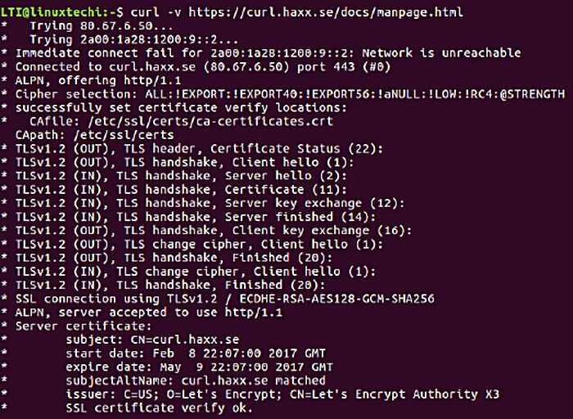
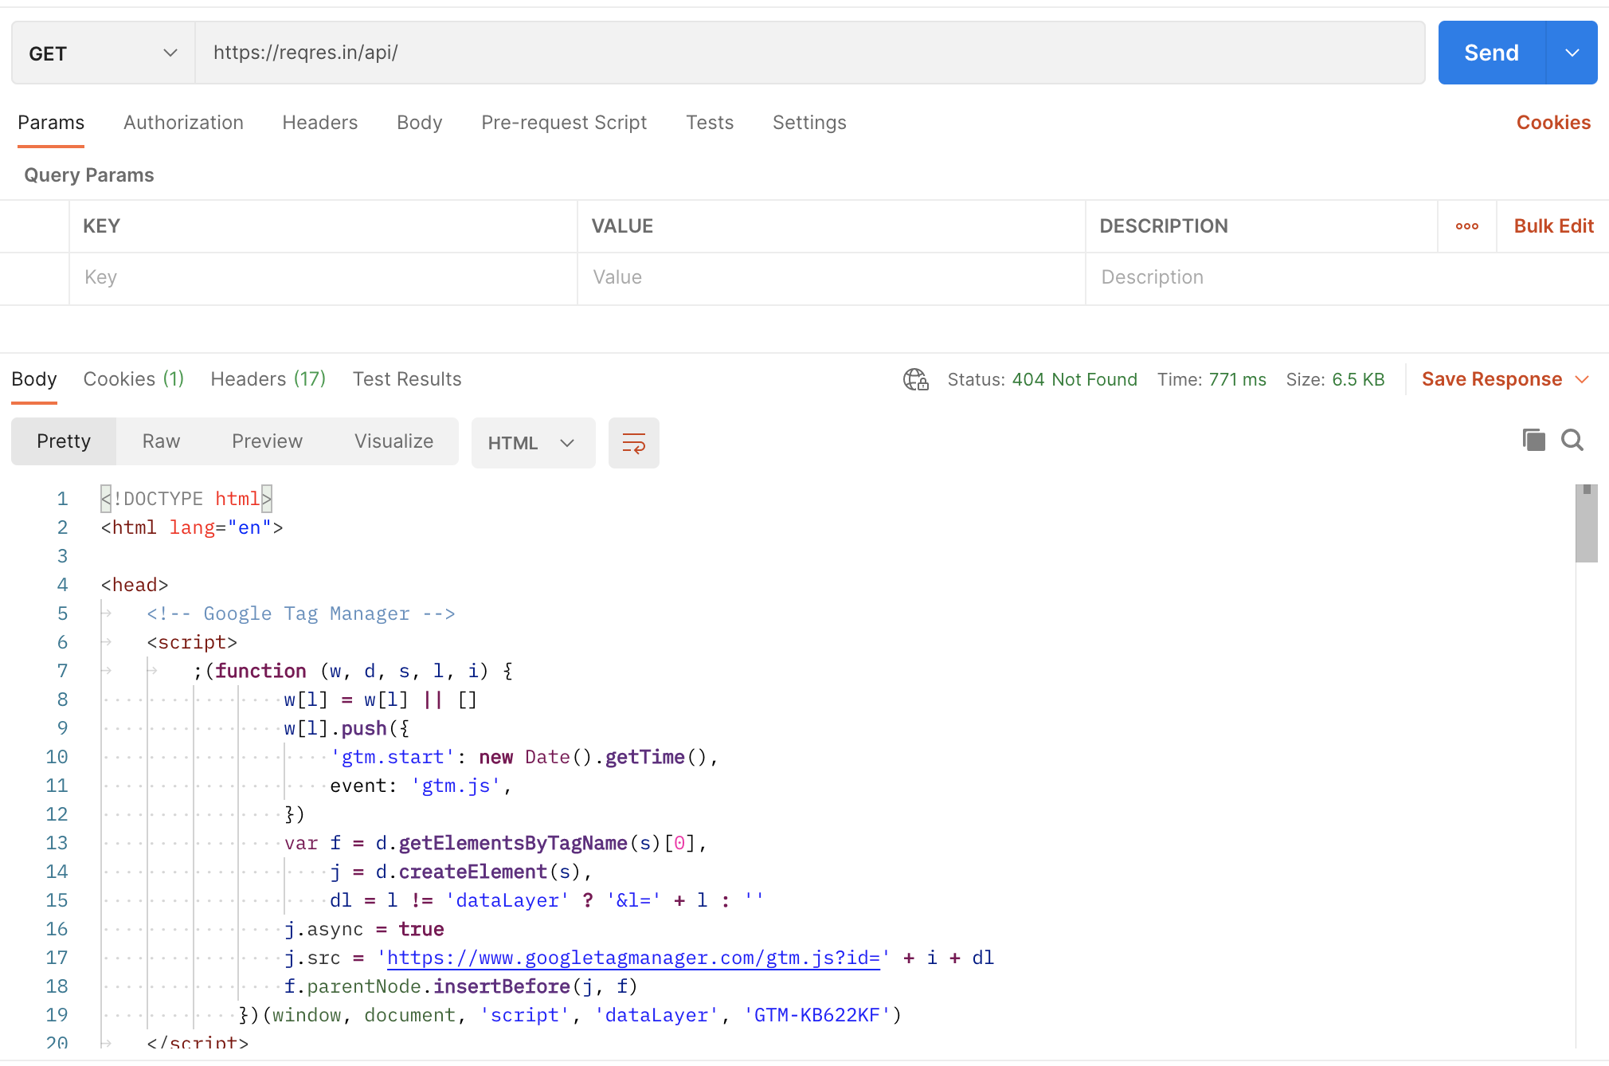
Working APIs: Then and Now
cURL Command Line
Postman

Slide 11
Requests and Responses
Notes:
Now that we’ve talked about what an API is, let’s talk about requesting and receiving data with one.

Slide 12
Request-Response Pattern
Client
Network
Server
Request
API
Response
Resources
Services
Notes:
A client is the entity that makes a request to a server. Somes examples of clients are applications like web browsers.
A server controls resources and services. An API is the interface that exposes these resources + services to clients in a network.
The client can interact with an API by making requests over the network to the API. The API will then evaluate the request, perform the required operations, maybe interact with a database or other APIs, then send back a response to the client.
Postman is a client that allows you to make requests and view responses from servers.

Slide 13

Making Requests
How we interact with the API
The three ingredients to make a request:
Method (GET, POST, etc)
Address/Endpoint (URL)
Path
Notes:
Requests are how we communicate with the API. You need three things to make an API request: the method, the URL, and a path
These elements let the API know what kind of request you’re making and where to send the request.

Slide 14
Requests - Methods and Endpoints
Bare minimum for a request
Method
GET | Retrieve information
POST | Send information
PUT/PATCH | Update information
DELETE | Delete information
address of the server
Host
https://www.google.com/search
Protocol
Path
The scheme of the request
destination where request can be heard and executed
Notes:
When we make a request to an API, we specify what we want to get out of this interaction with an HTTP method. Methods are like verbs, they’re actions. They let the client, like Postman, know which action to use for the URL. There’s a lot of methods out there, but the ones we’ll use today are the most commonly used: GET, POST, PUT, and DELETE. In Postman, by default the first method is GET. If you click the arrow pointing up, you can see the rest of Methods.
PUT vs PATCH: Patch is for updating partial data of a record while keeping the other data, whereas PUT requests are designed to completely overwrite the existing data for a record.
In addition to a method, and API request requires an endpoint. An endpoint includes a url with a path

Slide 15

Specifying Detail
Building your requests
Parameters
In the query
Authorization
Headers and body
Data types
Notes:
When you make an API call with a GET method, it will usually retrieve everything from the URL address. This can be pretty overwhelming.
Parameters specify (or filter out) the response so you can get the specific data you’re looking for.
Next up are Authorization options.
Since this is a 101 session, we won’t go over the full details of authorization. In general, authentication lets the API know what permissions the client has, and determines what data can be requested. This typically starts out with verifying the developer/user. One of the most common types of authorization that you’ll see, and one we’ll use today, is an API key. Other forms of authentication include access tokens, clientId or clientSecret keys
Then there’s Headers.
Headers are metadata for the request. Some APIs require you to send particular headers that’s not shown in the URL, unlike how Parameters show the key value pair. It’s common practice to send some authorization data, like access tokens and such, in the header.
Finally, there’s the Body. This is mainly used for POST or PUT methods where you need to specify the data you need to send with a request. Typically you will send a JSON object in the body.

Slide 16
Requests - Body
The data payload
Optional, but often supplied with POST and PUT requests
Data types
form data
JSON
text
HTML
XML
files
GraphQL
… and more!
JSON
{
“name”: “Jane Doe”,
“email”: “janedoe@email.com”,
“birthYear”: 1970
}
Notes:
A body can also be sent to the client by the server in a response

Slide 17

Receiving Responses
Response elements
Status codes (200 OK, 201 Created, 404 Not found)
Headers
Accessing body data
Notes:
We went over how to set up API requests and send them via Postman. When you send an API call, you will receive a Response
This includes status codes (200, 400, etc) and any Headers that were sent
*show in Postman app*
When you make an API call, you will see the response values at the bottom.
For Status, 200 OK is usually the best response that the API works as 200 OK means Successful. Most common examples are:
201 Created, 400 Bad Request, 401 Unauthorized, 403 Forbidden, 404 Not found.
There’s the time to show the latency in milliseconds. This is useful for testing for performance
Response size breaks down the size into body and headers.

Slide 18

Follow Along
Navigate to and fork
https://tinyurl.com/3vt73u4c
Notes:
Go ahead and navigate to this public workspace and fork it so you can follow along. You’ll need this later to finish out the workshop.
Alternative URL: https://www.postman.com/postman/workspace/postman-student-api-101-workshop

Slide 19

Recap
We learned request essentials to retrieve and update API data:
Methods
Addresses
Parameters
Authorization
Body data
Notes:
Recommend working through the collection again after to reinforce what we learned

Slide 20

Continue Learning APIs as a Student Expert
Student Expert certification indicates that you are proficient in the essential skills involved in building and testing API requests in Postman, including:
Sending more sophisticated requests in Postman.
Editing documentation for a collection.
Writing basic test scripts.
Running collections, passing data between requests, and scripting request execution order.
Have the option to become a Student Leader in your community

Slide 21

Postman Student Expert
Apply here: https://bit.ly/postman-student-program
Notes:
Opportunity for students to get certified.

Slide 22
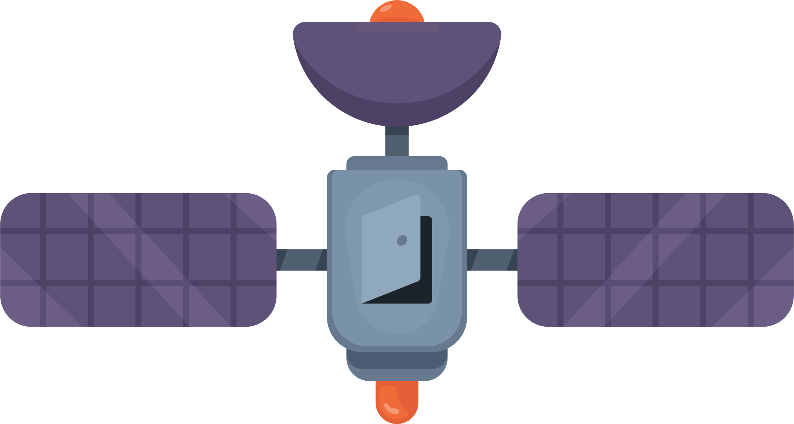


Win
Amazing
Swag

Slide 23


Share your learnings with
#PostmanStudent

Slide 24
Public Workspace
1
2
Create your own public workspace with a collection using any API of your choice
postman.com
Send it to us, and we’ll send cool swag to the coolest project
<<Link will be shared 24hrs later>>
Notes:
You can do Blogpost challenge or Public workspace challenge
Ask for the Link from your point of contact after 24 hrs of the Event.

Slide 25
Blog writing competition!
1
2
Write what you learned during the session on your favorite platform like medium or dev.to
Use #PostmanStudent #PostmanAPI
Send it to us, and we’ll send cool swag to the coolest blog
Submit your blog URL to organizers
Notes:
You can do Blogpost challenge or Public workspace challenge
Be sure to get winning student’s contact information. Only need winning student email’s address. Be sure to let

Slide 26

Resources
learning.postman.com
Learning Center
explore.postman.com
API Network
community.postman.com
Forum
Notes:
Recommend trying out more templates from explore.postman.com
(we can optionally suggest topics for further learning)

Slide 27

Q&A
Notes:
Open for Q&A, and attendees can continue getting support completing their collections

Slide 28
Thanks for coming!
Tell us how the workshop went:
Have a question we didn’t cover? Email me at 20kb1a0581@nbkrist.org
Notes:
Make a copy of the following as your feedback form, with your event name: https://docs.google.com/forms/d/13VaqaD6fxM7C62jwknAjIHSirWTkjzpNeBFDT5hVlfw/copy?usp=sharing

